Slide 1


Anomaly Detection A Comprehensive Overview of Methods and Applications of K-Means Based Detection Methods
WELCOME
Introducing the K-Means Based Anomaly Detection Algorithm and its Analysis on the Modified Version of UCI Housing Dataset
Notes:
In the era of big data, anomaly detection is crucial to ensure data quality and discover valuable insights. We will review the anomaly detection algorithm, and design an anomaly detection algorithm based on K-mean cluster, and use it in the dataset for practice.

Slide 2

Hello! I’m Wangjun Shen
Program: Master of Data Science
School: The University of South Australia
Course: Unsupervised Methods in Analytics
Notes:
My name is Wangjun Shen, and I am currently pursuing my studies at the College of Science, Engineering, and Technology at the University of South Australia in Adelaide. I am passionate about exploring the fascinating world of data science and its applications. Currently, I am focusing on my academic journey and actively engaging in research and coursework related to data science and analytics. I am very happy to be able to give you this talk today

Slide 3

Did you know Anomaly Detection?
A What is Anomaly Detection...
Why use Anomaly Detection
Identify data points
significantly deviate from the expected behavior
data errors, system faults, etc
Big Data
prevent risk
Improve efficiency
Notes:
Anomaly detection is a powerful technique used to identify data points that behave unusually or deviate significantly from what is expected. These deviations, known as anomalies or outliers, can be caused by factors like data errors, system faults, or fraudulent activity. As we continue to generate and collect more data than ever before, anomaly detection has become increasingly important. It helps identify unusual patterns within large datasets, which in turn helps prevent risks and improves overall efficiency. For example, in finance, anomaly detection helps identify fraudulent transactions, reducing financial losses. In healthcare, it helps detect disease outbreaks, aiding in prevention and control. In manufacturing, it identifies equipment failures, reducing downtime and boosting productivity. By detecting anomalies, we can make better informed decisions and take actions to mitigate their impact, ultimately leading to better outcomes.

Slide 4
three main categories of methods
Statistical methods
Machine learning methods
Rule-based methods
follows a certain distribution
deviates
significantly from this distribution
supervised
or
unsupervised learning
a set of rules
Notes:
There are different methods to identify anomalies in data. Statistical methods assume that the data follows a certain distribution and identify anomalies as any data point that deviates significantly from this distribution. This method is suitable for low-dimensional data with a clear statistical distribution. Machine learning methods use supervised or unsupervised learning to identify anomalies. Supervised learning uses labeled data to train a model that can identify anomalies in new data, while unsupervised learning uses unlabeled data to identify anomalies based on deviations from the expected pattern. This method is suitable for high-dimensional data or data with complex relationships. Rule-based methods use a set of rules to identify anomalies based on domain knowledge or statistical thresholds. It is suitable for situations where there is a clear set of rules that can be applied to identify anomalies.

Slide 5

Review of Anomaly Detection Using Clustering
01 Clustering-based
02 Distance-Based
03 Density Estimation
04 Subspace Clustering
05 Hierarchical Clustering
06 Compare
partition data into clusters
identify exceptional clusters
density thresholds
distance measurements
Then, we will talk about this.
local density within subspaces
Quality and stability
of cluster hierarchies
Robustness, dimension, Sparse, global, Computing costs
Notes:
Anomaly detection via clustering is a popular technique that divides data points into clusters and uses metrics to identify exceptional clusters as anomalous. Different clustering methods exist, such as distance-based, density estimation, subspace clustering, and hierarchical clustering. Each method has its strengths and limitations, depending on factors such as dimensionality, data sparsity, and computational resources. Distance-based clustering measures distance between data points and clusters them based on density thresholds to detect anomalies. Density estimation calculates the local density of each point and compares it to the densities of its neighbors to identify anomalies. Subspace clustering analyzes the local density within subspaces to detect anomalies, and hierarchical clustering identifies anomalies by examining the quality of cluster hierarchies and their stability.

Slide 6
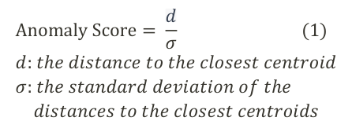
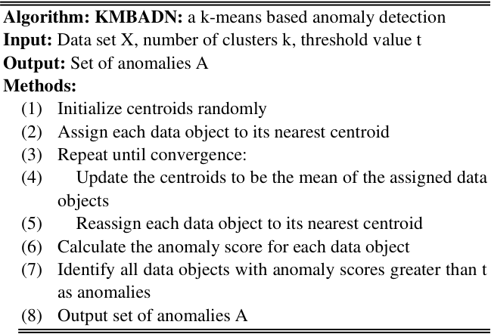
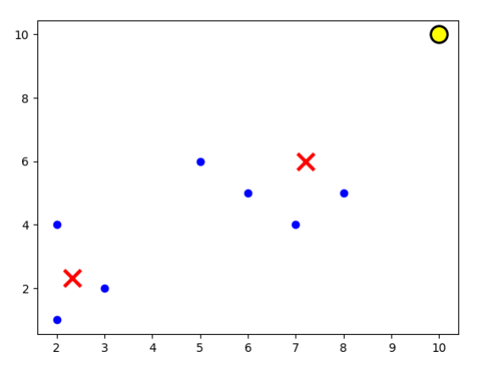
K-Means Based Anomaly Detection Algorithm
Define Anomaly Score
Example Dataset k=2 and t=3
(2,1), (2,4), (3,2), (5,6), (6,5), (7,4), (8,5), (10, 10)
Design the Algorithm
Visual The Result
Notes:
Anomaly score measures how anomalous a data object is to its closest cluster center. It is calculated by dividing the distance to the nearest centroid by the standard deviation of the distances to the closest centroids. This score is useful because it identifies data objects that are far from any cluster center or in sparsely populated areas of the data space, making them more likely to be considered anomalies.
The KMBADN algorithm is an anomaly detection approach based on k-means. The algorithm requires a dataset X, the number of clusters k, and a threshold value t as input. Initially, centroids are randomly initialized and each data object is assigned to its closest centroid. The algorithm repeats this process until convergence by updating centroids to the means of the assigned data objects and reassigning each data object to its nearest centroid. The algorithm then computes the anomaly score for each data object and identifies all data objects with anomaly scores greater than t as anomalies. The algorithm outputs the set of anomalies A. In summary, the KMBADN algorithm leverages k-means clustering to identify anomalies in a dataset by detecting data objects that are far from their assigned centroid. This algorithm was created by myself and is a simple and clear algorithm.
We can use a sample data to visualize the result of alrogithm, it can be seen it works well.

Slide 7
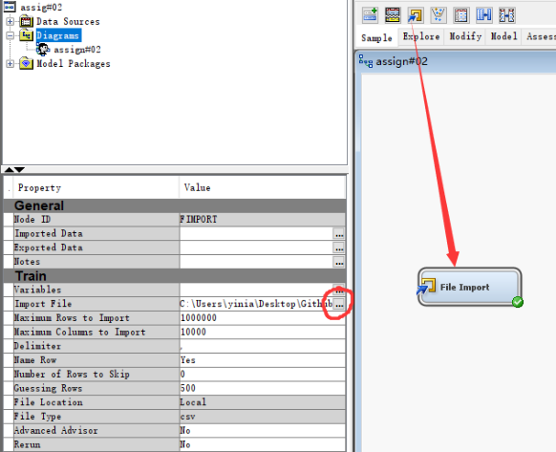
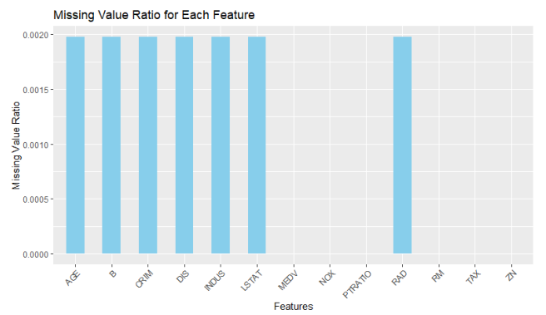
Import Data and Explore
Import Data Set
Missing Value
Notes:
First, we use the File Import provided by SAS EM to import data, and check the distribution of missing values in the data. We can find that some features have missing values, but the proportion is very low, so we can directly remove the data containing missing values

Slide 8
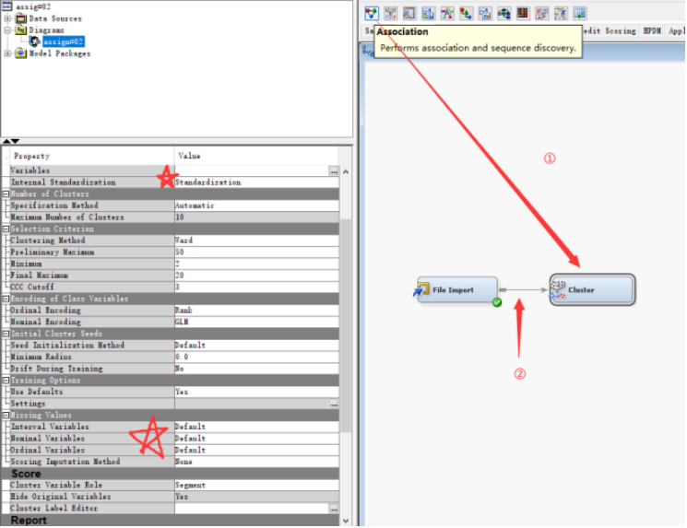
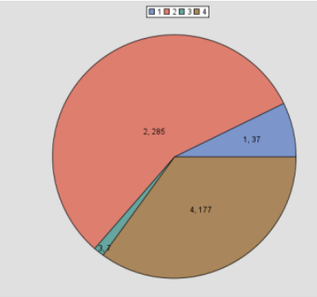
Cleaning Data and Clustering
Cluster Results
Cleaning and Clustering
Notes:
Then we use the Cluster Node provided by SAS EM to perform cluster analysis on the imported data. Because the scales of different features are different, we use the Standardization method for scaling, and then set the parameters of Missing Values to default. It means that the Missing Values data will be ignored during the clustering process.

Slide 9
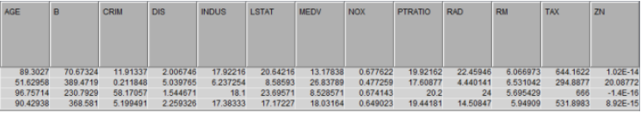

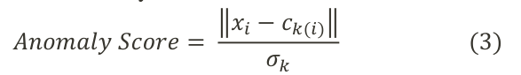
Find Anomaly Data
Centroid of Clusters
Calculate the shortest distance
Calculate Anomaly Score
Notes:
SAS EM provides the specific value of each Centroids, through these values, we calculate the nearest Centroids of each data, and assign the data to this cluster.
Then we calculate the Anomaly Score of each data.

Slide 10
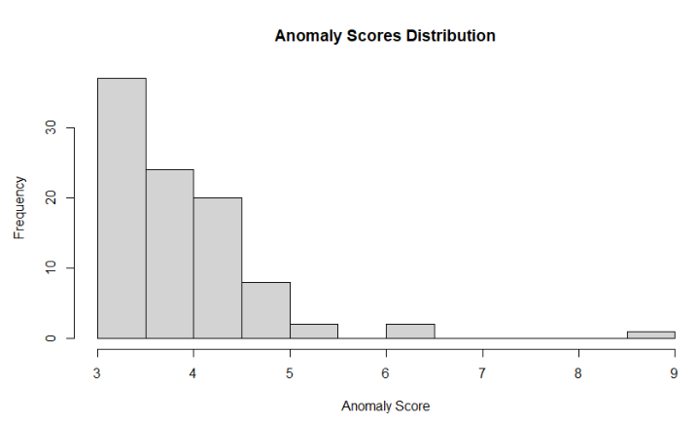
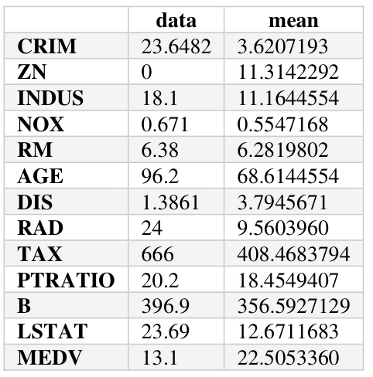
Explore Anomaly Data
Anomaly Scores Distribution
Explore the Data with the Largest Anomaly Score
Notes:
We use visualization tools to view the distribution of Anomaly Score
It can be found that most of the data are distributed between 3~4 and 4~5, but one data has an Anomaly Value of 9, which is much higher than other data.
Extracting this data and comparing it with the average value, we can find that the CRIM feature value of the data is 23.64, while the average value is only 3.62, which can be regarded as the reason for the extremely high Anomaly Score of the data.
It can be speculated that other selected data have similar problems, but because the value of Anomaly Score is low, the gap between a certain feature and the average is not so obvious.

Slide 11
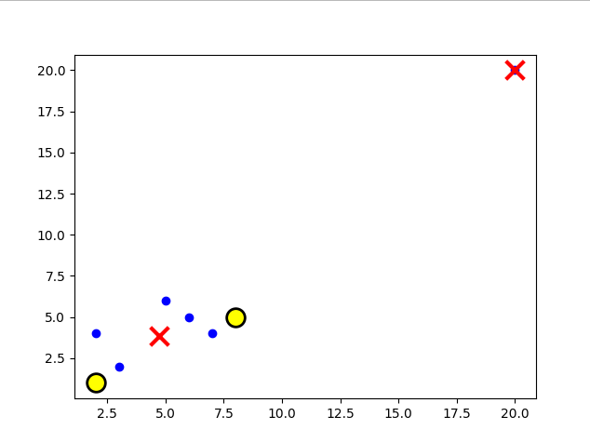
The problem with the algorithm
Example Dataset:
(2,1), (2,4), (3,2), (5,6), (6,5), (7,4), (8,5), (10, 10)
Example Dataset:
(2,1), (2,4), (3,2), (5,6), (6,5), (7,4), (8,5), (20, 20)
k = 2
t = 3
Visualization for Dataset 1
Visualization for Dataset 2
Notes:
Although the algorithm is effective in brief, it also has a defect, that is, when setting the number of clusters for k-means, it may cause an outlier value to be set as centroids due to a large gap with other values, resulting in some normal values being judged as an outlier.
We modified one of the data in the previous example and showed the result through visualization, which can be well observed.
In the next research, we can try to combine other algorithms to solve this problem.

Slide 12

Thank you!
THANK
YOU
If you have any question
shewy009@mymail.unisa.edu.au
https://github.com/YeJiu97
https://yejiu97.github.io/

